Slide 1

Machine learning logistic regression
Presented by :-
Hrishikesh Deshpande

Slide 2
Logistic regression
Basically, logistic regression is type of classification problem and type of supervised learning algorithm.
It is used where variable i.e. label is categorical.
Mainly it finds relationship between features and probability of particular outcome.
E.g. If we have to predict students graduated from this college or not, based on feature is no. of students then response variable has two values ---→ yes or no.
So, in this case linear regression doesn’t work because it needs continuous data so we have to use logistic.

Slide 3
Function in logistic regression
Logistic regression uses this function and it converts independent variable in terms of probability where it ranges between 0 and 1, w.r.t. dependent variable, this function is known as Sigmoid Function.
So, as we passes those independent variable to this function it converts value in probability range of 0 to 1.
We wouldn’t have points in linear nature so to make them in linear nature so we can plot them accurately, we uses Sigmoid Function.
Y = 1 / 1 + e^(-x) ---→ Where Y = value we get to plot as Sigmoid value.
X = each value of independent variable which gets transformed.
e = 2.718 Constant value.
Natural logarithm base or Euler’s number.

Slide 4
Types of logistic regression
There are 3 types of Logistic Regression :
1. Binomial Logistic Regression :
It uses when target variable or labels have only 2 possible values like “0” or “1” and win or loss , yes or no , pass vs. fail , accept or decline, etc. this type of data.
2. Multinomial Logistic Regression :
We use this LR if target variables or labels have 3 or more possible values.
Here, Order does not matter for predicting values for labels. (have no quantitative nature).
It can be like “Vehicle 1” vs “Vehicle 2” vs “Vehicle 3” ,here order doesn’t matter.

Slide 5
3. Ordinal Logistic Regression :
It has same nature like Multinomial like we if labels are 3 or more but, here Order does matter.
Like, we can take data for grading purpose. Here we have labels more than 3, but we have to arrange them in order
e.g. grades like ---→ very poor, poor, good, very good, excellent.
scores like ----→ 0, 1, 2, 3, 4.
The difference between these 2 is just about Order. else is same.

Slide 6
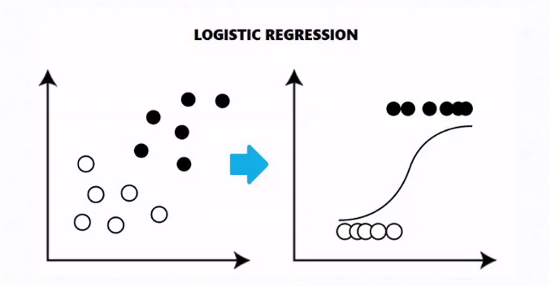
Applications of logistic regression
Fraud Detection
Email spam or not
Disease diagnosis
Detection of things
Logistic regression is used in
Deep Learning also.
Logistic Regression is simple and efficient, has low variance.
And it provides mainly probability for observation.
But, we cannot use in large dataset of categorical labels, coz it will take more time and computation also.

Slide 7
Why logistic regression used to solve classification problems ?
According to name it shows it will do computation for Regression, but basically it deals with independent variables and on labels which are categorical in nature.
And for categorical data we use Classification.
And mainly, Logistic regression is not called as Logistic classification even though its a classification algorithm because it produces real values of output based on the input features just like linear regression.
But here these real values are applied to a sigmoid or logistic function. Therefore any value greater than 0.5 gets labeled as positive class and other labelled as negative class just like yes or no labels. Yes --→1 and No --→ 0

